Slide 1
CHAPTER-8: Design of belt
Tribhuwan University
Institute of Engineering
Pulchowk Campus

Slide 2
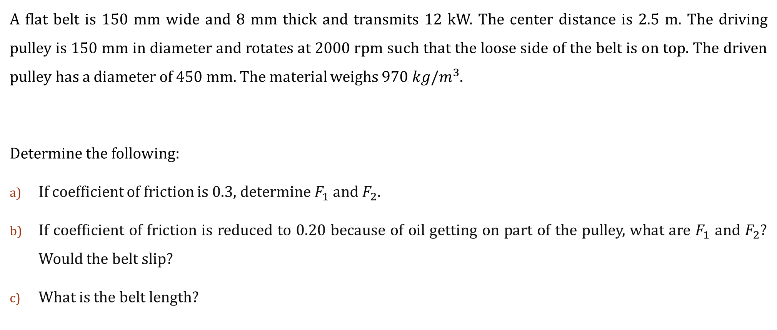

Forces on a flat belt
A flat belt is 150 mm wide and 8 mm thick and transmits 12 kW. The center distance is 2.5 m. The driving pulley is 150 mm in diameter and rotates at 2000 rpm such that the loose side of the belt is on top. The driven pulley has a diameter of 450 mm. The material weighs $970 kg/m^{3}$.
Determine the following:
If coefficient of friction is 0.3, determine $F_{1}$ and $F_{2}$.
If coefficient of friction is reduced to 0.20 because of oil getting on part of the pulley, what are $F_{1}$ and $F_{2}$? Would the belt slip?
What is the belt length?

Slide 3
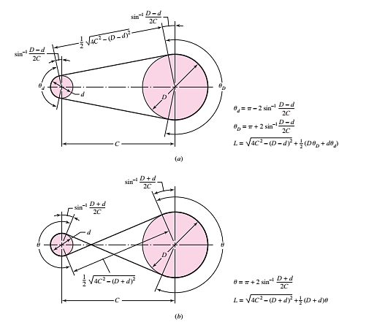
Terms used in flat belt pulley

Slide 4



Flat Belt SOLUTION_First part
Velocity of belt, V
$$V=πdN$$
$=15.7 m/s$
We have,
d = diameter of driving pulley = 0.15 m
N = speed of driving pulley = 2000 rpm
Weight per unit length of belt, $ω$
$$ω=γbt$$
$$=11.42 N/m$$
We have,
b = width of belt = 0.15 m
t = thickness of belt = 0.008 m
$γ$ = weight density = $970×9.81=9515 N/m^{3}$

Slide 5


Flat Belt SOLUTION_First part_Contd…
Centrifugal force acting on the plate, $F_{c}$
$$F_{c}=\frac{ωV^{2}}{g}$$
$=\frac{11.42×{15.7}^{2}}{9.81}$
$=286.94 N$
Wrap angle or Contact angle, $φ$
$$φ=θ_{d}=π−2\sin^{−1}\left[\frac{D−d}{2C}\right]$$
$=π−2\sin^{−1}\left[\frac{0.45−0.15}{2(2.5)}\right]$
$$=173.12°$$
We have,
d = diameter of driving pulley = 0.15 m
D = diameter of driven pulley = 0.45 m
C = center to center distance = 2.5 m

Slide 6
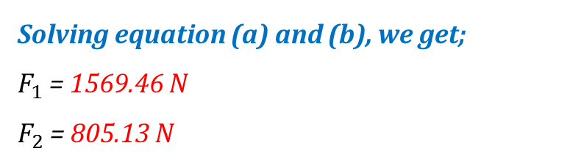

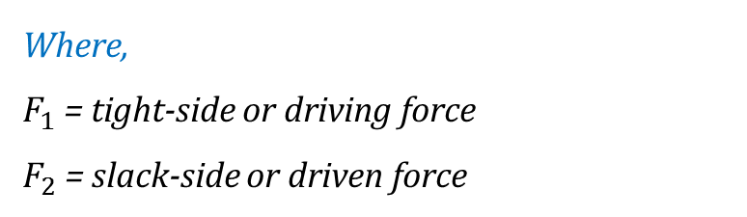

Flat Belt SOLUTION_First part_Contd…
Determination of Belt Tension, $F_{1} \&{ F}_{2}$
Solving equation (a) and (b), we get;
$F_{1}$ = 1569.46 N
$F_{2}$ = 805.13 N
Transmitted power, H
$$H=\left(F_{1}−F_{2}\right)×V$$
$$⟹\left(F_{1}−F_{2}\right)=\frac{H}{V}$$
$∴\left(F_{1}−F_{2}\right)=\frac{12000}{15.7}=764.33 ……(a)$
Taking into consideration of centrifugal forces
$$\frac{F_{1}−F_{c}}{F_{2}−F_{c}}=e^{μφ}$$
$$⟹\frac{\left(F_{1}−286.94\right)}{F_{2}−286.94}=e^{0.3×\left(173.12°\right)×\frac{π}{180°}}=2.475$$
$$∴F_{1}−286.94=2.475\left(F_{2}−286.94\right)……(b)$$
Where,
$F_{1}$ = tight-side or driving force
$F_{2}$ = slack-side or driven force

Slide 7

Flat Belt SOLUTION_First part_Contd…
Initial Belt Tension, $F_{i}$
$$F_{i}=\frac{F_{1}+F_{2}}{2}−F_{c}$$
$=\frac{1569.46+805.13}{2}−286.94$
$=900.36 N$

Slide 8

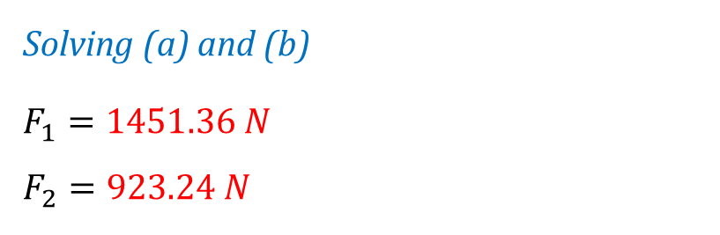
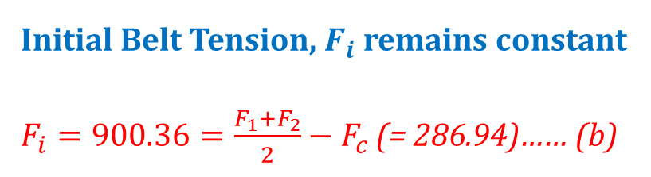
Flat Belt SOLUTION_Second part
When $μ=0.2$ instead of 0.3.
Taking into consideration of centrifugal forces
$$\frac{F_{1}−F_{c}}{F_{2}−F_{c}}=e^{μφ}$$
$$⟹\frac{\left(F_{1}−286.94\right)}{F_{2}−286.94}=e^{0.2×\left(173.12°\right)×\frac{π}{180°}}=1.830∴F_{1}−286.94=1.830\left(F_{2}−286.94\right)……(a)$$
Initial Belt Tension, $F_{i}$ remains constant
$F_{i}=900.36=\frac{F_{1}+F_{2}}{2}−F_{c}$ (= 286.94)…… (b)
Solving (a) and (b)
$$F_{1}=1451.36 N$$
$$F_{2}=923.24 N$$
Where,
$F_{1}$ = tight-side or driving force
$F_{2}$ = slack-side or driven force

Slide 9

Flat Belt SOLUTION_Second part_Contd…
Transmitted power, H
$H=\left(F_{1}−F_{2}\right)×$ V
$=\left(1451.36−923.24\right)×15.7$
$=8.291 kW$
Since, the power transmitted i.e. 8.291 kW is less than the required power i.e.12 kW, the belt will slip.

Slide 10


Flat Belt SOLUTION_Third Part
Where,
$$θ_{d}=π−2\sin^{−1}\left[\frac{D−d}{2C}\right]$$
$=π−2\sin^{−1}\left[\frac{0.45−0.15}{2×2.5}\right]=3.02 rad$
$$θ_{D}=π+2\sin^{−1}\left[\frac{D−d}{2C}\right]$$
$$=π+2\sin^{−1}\left[\frac{0.45−0.15}{2×2.5}\right]=3.26 rad$$
Belt Length, L
$$L={\left[4C^{2}−{\left(D−d\right)}^{2}\right]}^{\frac{1}{2}}+\frac{Dθ_{D}+dθ_{d}}{2}$$
$$={\left[4C^{2}−{\left(D−d\right)}^{2}\right]}^{\frac{1}{2}}+\frac{π(D+d)}{2}+\left(D−d\right)×\sin^{−1}\left[\frac{D−d}{2C}\right]×\frac{π}{180°}$$
= 5.95 m

Slide 11
Design of flat belt
A flat-belt drive is to consist of two 1.2 m-diameter cast iron pulleys spaced 4.8 m apart. Select a belt type to transmit 45 kW at a pulley speed of 380 rpm. Use a service factor of 1.1 and a design factor or 1.0.

Slide 12

Design of flat belt_Solution
Decision set for a flat belt
Function: power, speed, durability, reduction, service factor, C
Design factor: $n_{d}$
Initial tension
Belt material
Drive geometry, d, D
Belt thickness: t
Belt width: b
Shigley’s Book Page no: 893

Slide 13

Design of flat belt_Solution_Contd…
In our case, decision set for a flat belt
Function: $H_{nom}=45 kW,380 rpm, k_{s}=1.1, C=4.8 m$
Design factor: $n_{d}=1.0$
Initial tension: Catenary
Belt material: ???
Drive geometry: $d=D=1.2 m$
Belt thickness: t = ???
Belt width: b = ???

Slide 14

Design of flat belt_Solution_Contd…
Start with belt material selection
(Table 17-2) from Shigley’s book
(Table 4-1) from Data Handbook
Belt width, b = ???
Choose Polyamide A-3 belt
Allowable Tension, $F_{a}$ = 18 kN
Thickness, t = 3.3 mm
Specific Weight, $γ$ = 11.4 kN/m³
Coefficient of friction, $μ$ = 0.8

Slide 15
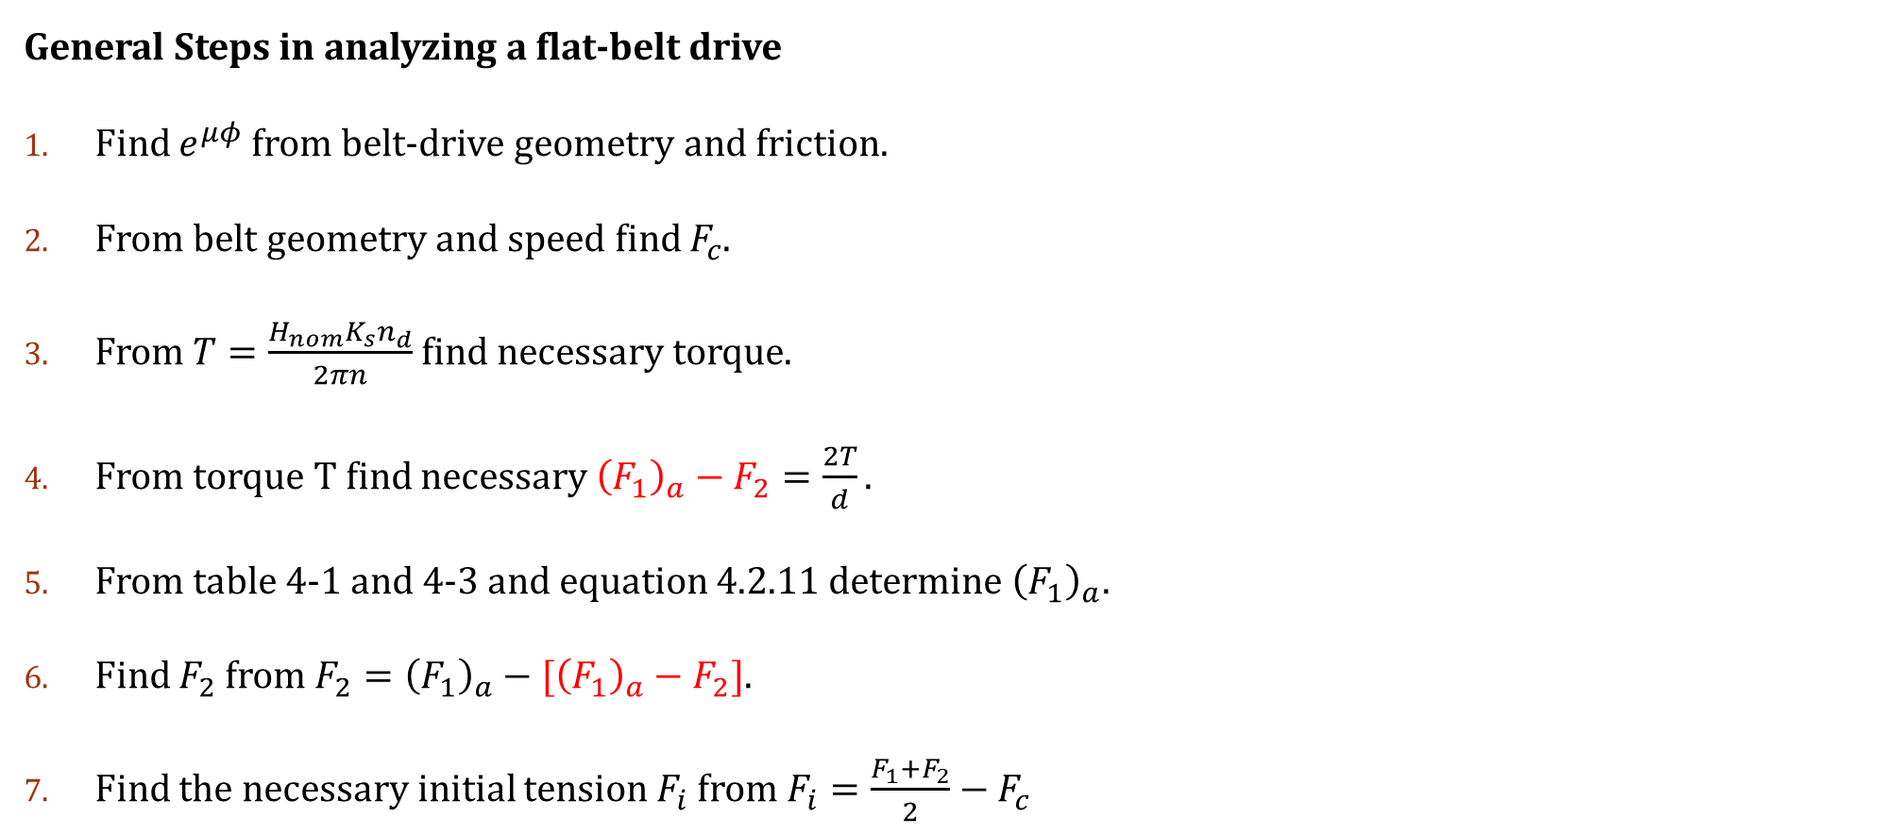

Design of flat belt_Solution_Contd…
General Steps in analyzing a flat-belt drive
Find $e^{μφ}$ from belt-drive geometry and friction.
From belt geometry and speed find $F_{c}$.
From $T=\frac{H_{nom}K_{s}n_{d}}{2πn}$ find necessary torque.
From torque T find necessary ${\left(F_{1}\right)}_{a}−F_{2}=\frac{2T}{d}.$
From table 4-1 and 4-3 and equation 4.2.11 determine ${\left(F_{1}\right)}_{a}$.
Find $F_{2}$ from ${F_{2}=\left(F_{1}\right)}_{a}−[{\left(F_{1}\right)}_{a}−F_{2}]$.
Find the necessary initial tension $F_{i}$ from $F_{i}=\frac{F_{1}+F_{2}}{2}−F_{c}$
8. Check the friction development, $μ^{′}<μ.$
$$μ^{′}=\frac{1}{φ}×\ln{\frac{{\left(F_{1}\right)}_{a}−F_{c}}{F_{2}−F_{c}}}$$
Allowable power or design power
$H_{a}=H_{nom}×K_{s}×n_{d}$
10. Find the factor of safety $n_{fs}=\frac{H_{a}}{H_{nom}K_{s}}$

Slide 16
Design of V-belt
A 45-kW four cylinder internal combustion engine is used to drive a brick-making machine under a schedule of two shifts per day. The drive consists of two 650 mm sheaves spaced about 3.6 m apart, with a sheave speed of 400 rpm. Use a service factor of 1.4 and a design factor of unity.
Select a suitable V-belt arrangement.
Find the factor of safety, and estimate the life in passes and hours.

Slide 17
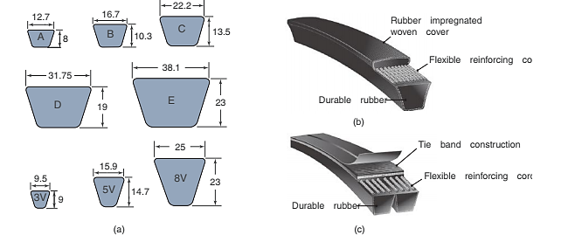
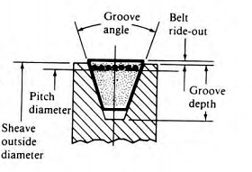
V-Belt geometry

Slide 18

Designing STEPS for V-Belt
Select a suitable V-belt.
Find $V, L_{p}, C, φ,$and $e^{0.5123φ}$.
Find $H_{d}, H_{a}$ and $N_{b}$ from $\frac{H_{d}}{H_{a}}$ and round up to nearest whole number.
Find $F_{c}, ∆F, F_{1}, F_{2}$ and $F_{i}$.
Find $n_{fs}$.
Find the belt life in number of passes, or hours, if possible.

Slide 19
Design of V-belt
Step-1: Selection of V-Belt
Design Data Handbook
Table 5-2: Inside Circumferences of Standard V Belts
Shigley’s Mechanical Engineering Design
Table 17-10: Inside Circumferences of Standard V Belts

Slide 20
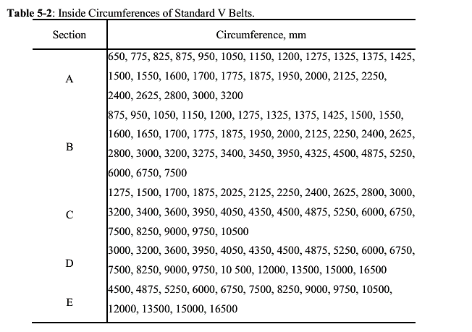
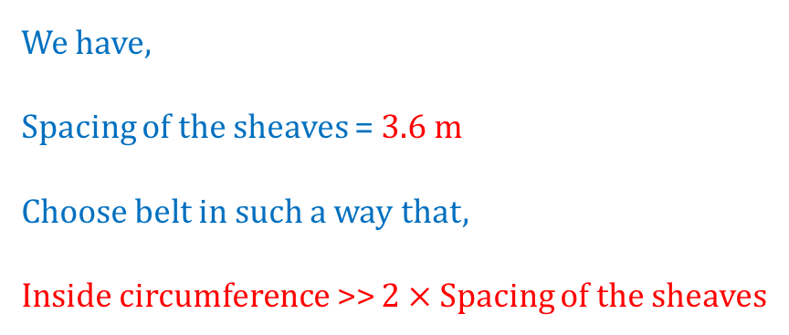
Inside Circumferences of standard V belts
We have,
Spacing of the sheaves = 3.6 m
Choose belt in such a way that,
Inside circumference >> $2×$ Spacing of the sheaves
For our problem,
Let us choose D8250 belt.

Slide 21
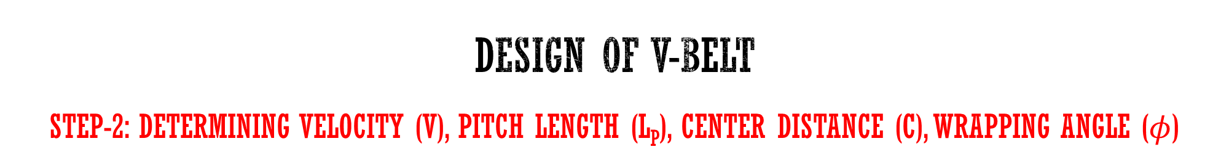


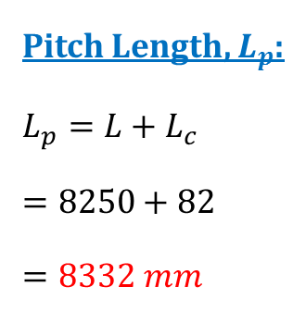
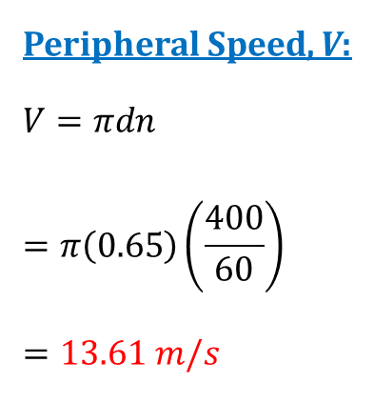
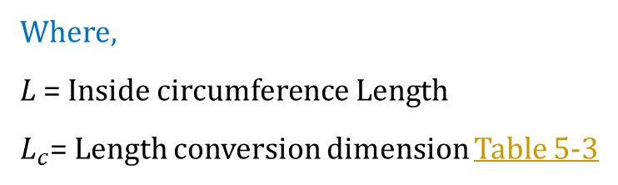
Design of V-belt
Step-2: Determining Velocity (V), Pitch length (L_{p}), center Distance (C), Wrapping angle ($φ$)
Peripheral Speed, V:
$$V=πdn$$
$$=π\left(0.65\right)\left(\frac{400}{60}\right)$$
$$=13.61 m/s$$
Center Distance, C:
$$C=0.25\left\{\left[L_{p}−\frac{π}{2}\left(D+d\right)\right]+\sqrt{{\left[L_{p}−\frac{π}{2}\left(D+d\right)\right]}^{2}−2{\left(D−d\right)}^{2}}\right\}$$
$$=0.25\left\{\left[8.332−\frac{π}{2}\left(0.65+0.65\right)\right]+\sqrt{{\left[8.332−\frac{π}{2}\left(0.65+0.65\right)\right]}^{2}}\right\}$$
$$=3.14 m$$
Wrapping Angle, $φ$:
$$φ=θ_{d}=π−2\sin^{−1}\left[\frac{D−d}{2C}\right]$$
$=π−2\sin^{−1}\left[\frac{0.65−0.65}{2\left(3.52\right)}\right]$
$$=π$$
Pitch Length, $L_{p}$:
$$L_{p}=L+L_{c}$$
$$=8250+82$$
$$=8332 mm$$
Where,
L = Inside circumference Length
$L_{c}$= Length conversion dimension Table 5-3

Slide 22
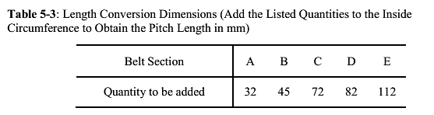
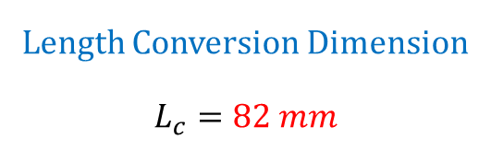
Length Conversion Dimension
We have,
Belt: D8250
Length Conversion Dimension
$$L_{c}=82 mm$$

Slide 23
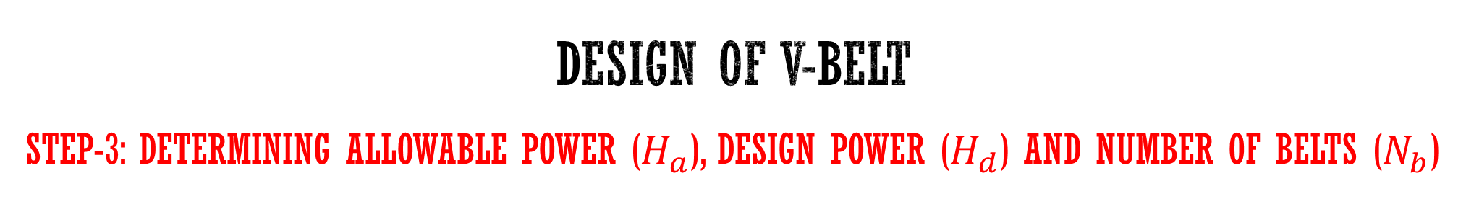
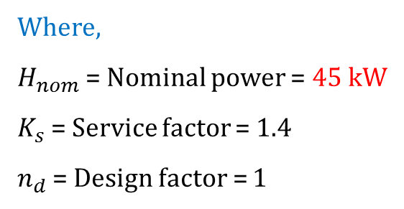



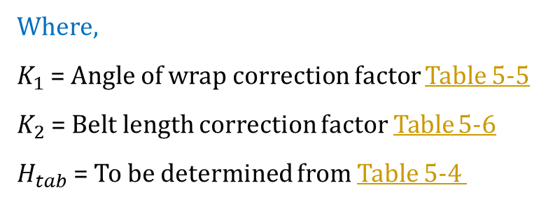
Design of V-belt
Step-3: Determining Allowable Power ($H_{a}$), Design Power ($H_{d}$) and Number of Belts ($N_{b}$)
Allowable Power per belt, $H_{a}$:
$$H_{a}=K_{1}K_{2}H_{tab}$$
$=$(1)(1.05)(12.63)
$$=13.26 kW$$
Where,
$K_{1}$ = Angle of wrap correction factor Table 5-5
$K_{2}$ = Belt length correction factor Table 5-6
$H_{tab}$ = To be determined from Table 5-4
Number of belts, $N_{b}$:
$$N_{b}=\frac{H_{d}}{H_{a}}$$
$=\frac{63}{13.26}$
$$=4.75→5$$
Design Power, $H_{d}$:
$$H_{d}=H_{nom}K_{s}n_{d}$$
$=$(45)(1.4)(1)
$$=63 kW$$
Where,
$H_{nom}$ = Nominal power = 45 kW
$K_{s}$ = Service factor = 1.4
$n_{d}$ = Design factor = 1

Slide 24
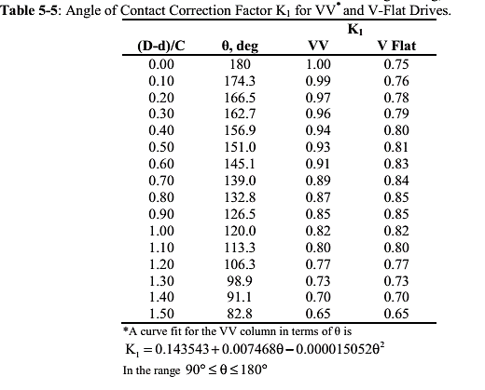
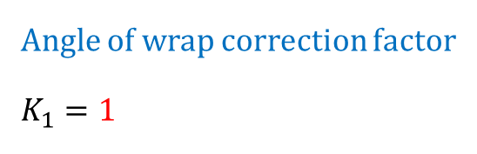
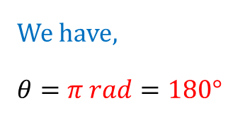
Angle of wrap correction factor
We have,
$$θ=π rad=180°$$
Angle of wrap correction factor
$$K_{1}=1$$

Slide 25
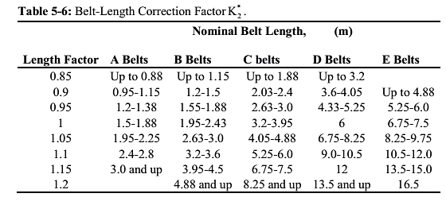
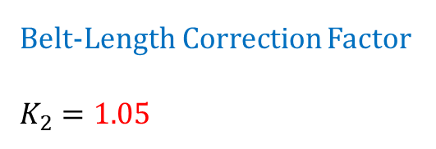
Belt-Length correction factor
We have,
Belt: D8250
Nominal Belt Length = 8250 mm
Belt-Length Correction Factor
$K_{2}=1.$05

Slide 26
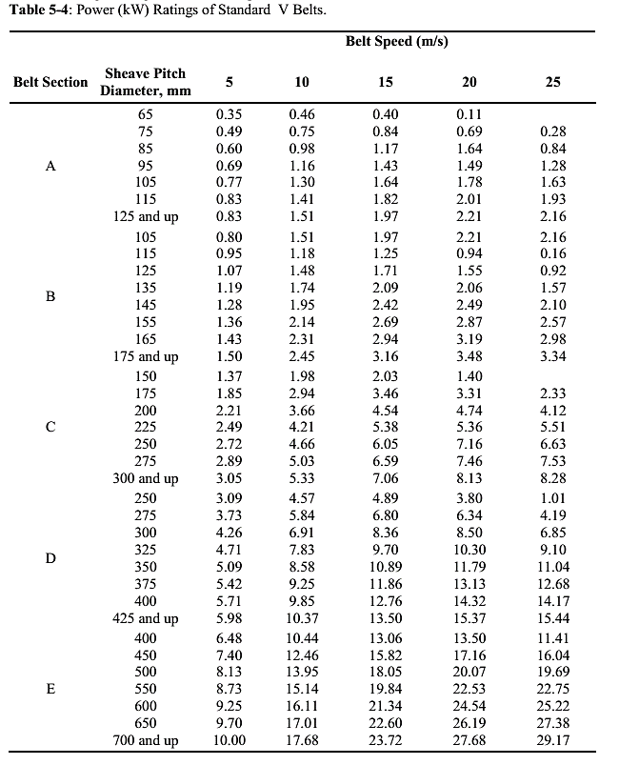
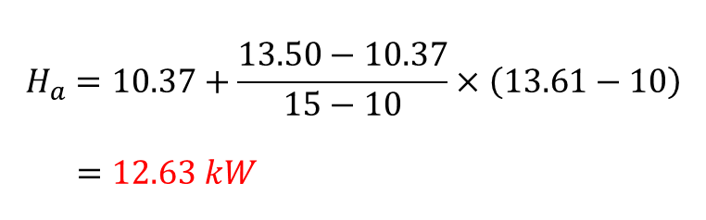

Rated Power (kW) of standard V belts
We have,
Belt: D8250
Sheave Diameter = 650 mm
Belt Speed = 13.61 m/s
Interpolating to get $H_{tab}$ for V = 13.61 m/s
Belt Speed (m/s) | Rated Power (kW)
10
10.37
12.63
13.61
??
15
13.50
$$H_{a}=10.37+\frac{13.50−10.37}{15−10}×\left(13.61−10\right)$$
$$=12.63 kW$$

Slide 27
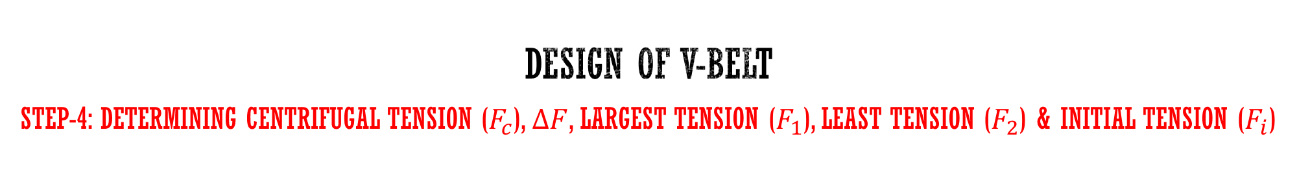






Design of V-belt
Step-4: Determining Centrifugal tension ($F_{c}$), $∆F$, Largest Tension ($F_{1}$), Least Tension ($F_{2}$) & Initial Tension ($F_{i}$)
Centrifugal Tension, $F_{c}$:
$$F_{c}=K_{c}\left(\frac{V^{2}}{2.4}\right)$$
$$=3.498\left(\frac{{13.61}^{2}}{2.4}\right)$$
$$=269.98 N$$
Where,
$K_{c}$ = To be determined from Table 5-8
V = Belt Speed = 13.61 m/s
Difference, $∆F$:
$$∆F=\frac{\left(\frac{H_{d}}{N_{b}}\right)}{πnd}$$
$$=\frac{\left(\frac{63000}{5}\right)}{π\left(\frac{400}{60}\right)(0.65)}=925.55N$$
Largest Tension, $F_{1}$:
$$F_{1}=F_{c}+\frac{∆Fe^{0.5123φ}}{e^{0.5123φ}−1}$$
$=269.98+\frac{925.55 e^{0.5123π}}{e^{0.5123π}−1}$
$$=1426.92 N$$
Initial Tension, $F_{i}$:
$$F_{i}=\frac{F_{1}+F_{2}}{2}−F_{c}$$
$$=\frac{1426.92+501.37}{2}−269.98$$
$$=694.17 N$$
Least Tension, $F_{2}$:
$$F_{2}=F_{1}−∆F$$
$=1426.92−925.$55
$$=501.37 N$$

Slide 28



Determining value of $K_{c}$
We have,
Belt Section: D8250
$K_{c}=3.$498

Slide 29


Design of V-belt
Step-5: Determining Factor of safety ($n_{fs}$)
Factor of Safety, $n_{fs}$:
$$n_{fs}=\frac{H_{a}N_{b}}{H_{nom}K_{s}}$$
$$=\frac{(13.26)(5)}{(45)(1.4)}$$
$=1.05$ which is greater than 1. Hence OK.

Slide 30




Design of V-belt
Step-6: Belt-Life in Passes
Number of Passes, $N_{p}$:
$$N_{p}={\left[{\left(\frac{K}{T_{1}}\right)}^{−b}+{\left(\frac{K}{T_{2}}\right)}^{−b}\right]}^{−1}$$
$$={\left[{\left(\frac{18726}{2414.63}\right)}^{−11.105}+{\left(\frac{18726}{1489.08}\right)}^{−11.105}\right]}^{−1}$$
$$=7.5\left(10\right)9 passes$$
Where,
$T_{1}$ = Equivalent tension at driving sheave
$T_{2}$= Equivalent Tension at driven sheave
$K$ & b = Durability Parameters Table 5-9
$T_{1} and { T}_{2}$:
$$T_{1}=F_{1}+\frac{4.45{ K}_{b}}{39.37 d}$$
$$=1426.92+\frac{4.45×5680}{39.37×0.65}$$
$$=2414.63 N$$
$$T_{2}=F_{2}+\frac{4.45{ K}_{b}}{39.37 d}$$
$$=501.37+\frac{4.45×5680}{39.37×0.65}$$
$$=1489.08 N$$
Where,
$K_{b}$ = To be determined from Table 5-8
D = Diameter of driven pulley = 650 mm
d = Diameter of driving pulley = 650 mm

Slide 31


Determining value of $K_{b}$
We have,
Belt Section: D8250
$$K_{b}=5680$$

Slide 32



Durability parameters $K$ and $b$
We have,
Belt Section: D8250
From Table
$$K=18726$$
$$b=11.105$$

Slide 33

Design of V-belt
Step-6: Belt-Life in Hours
Belt life in hours, t:
Since $N_{p}>10^{9},$ So $N_{p}=10^{9}$.
$$t>\frac{N_{p}L_{p}}{3600V}$$
$$t>\frac{{(10}^{9})( 8.332)}{3600(13.61)}=170055 h$$

Slide 34
THANK YOU

